Slide 1

Full Stack Development - 22CS2305
MODULE 2 – CSS3
Prof. Suvika K V,
Assistant Professor,
Dept. of CSE

Slide 2
Theory - Modules
Module | Chapter | Chapter Name
1 | 1 | Markup Language (HTML5)
2 | 2 | CSS3
3 | 3 | JavaScript
4 | 4 | Node JS
5 | 5 | Express.JS

Slide 3
Module 2 - CSS3
Topics
Levels of style sheets Style specification formats Selector forms Property value forms Font properties List properties Color Alignment of text Background images Conflict Resolution CSS Box Model CSS3 features: Box Shadow, Opacity, Rounded corners, Attribute selector

Slide 4
Introduction - What is CSS ?
CSS stands for Cascading Style Sheets.
CSS describes how HTML elements are to be displayed on screen, paper, or in other media.
CSS can control the layout of multiple web pages all at once.
CSS is used to define styles for your web pages, including the design, layout and variations in display for different devices and screen sizes.

Slide 5
Introduction – Advantages of CSS ?
Saves time
Easy to change
Keep consistency (always behave in the same way)
More control over layout
Create a common format for all the Web pages

Slide 6
1. Levels of Style Sheets
The Cascading Style Sheets is defined at three different levels to specify the style of a Document.
Lower level style sheets can override higher level style sheets , so the style of the content of a tag is determined ,in effect ,through a cascade of style sheet applications.
Inline style sheets have precedence over document style sheets ,which have precedence over external style sheets.
Levels in CSS
Inline
Document/ Internal
External

Slide 7
i. Inline Styles
Inline style sheets apply to content of single HTML element.
Inline style specifications appear within the opening tag and apply only to the content of that tag.

Slide 8
ii. Document/ Internal Styles
Document level style sheets apply to the whole body of a document.
Document level style specifications appear in the document head section and apply to the entire body of the document.

Slide 9
iii. External Styles
External Style sheets can apply to the bodies of any number of documents.
External Style sheets stored separately and are referenced in all documents that use them
External style sheets are written as text files with the MIME type text/css.
The browser fetches external style sheets just as it fetches documents.

Slide 10
Gist of Levels of CSS
Inline Styles: These are specified in the tag itself.
Document-Level (Internal) Style Sheets: These are specified in the <head> of a document, using the special tag <style>.
External Style Sheets: These are specified in a separate CSS file that is connected to the HTML file by the <link> tag.

Slide 11
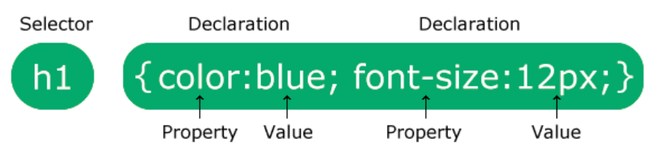
Syntax
A CSS rule consists of a selector and a declaration block.
The selector points to the HTML element you want to style.
The declaration block contains one or more declarations separated by semicolons.
Each declaration includes a CSS property name and a value, separated by a colon.
Multiple CSS declarations are separated with semicolons, and declaration blocks are surrounded by curly braces.

Slide 12
Syntax
h1 is a selector in CSS (it points to the HTML element you want to style: <h1>).
color is a property, and blue is the property value
Font-size is a property, and 12px is the property value

Slide 13
Inline Styles – Code 1
<!DOCTYPE html>
<html>
<head>
<title>Inline</title>
</head>
<body>
<h1 style = "font-family : Lucida Handwriting;
font-size : 50pt;
color : red;
text-align : center;"> Dayananda Sagar University </h1>
</body>
</html>

Slide 14
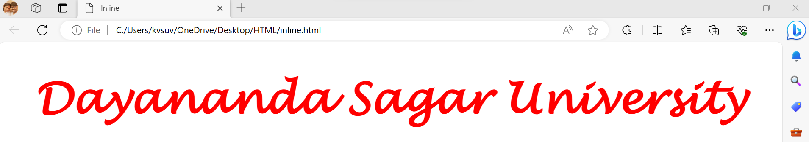
Inline Styles – Code1 - Output

Slide 15
Inline Styles – Code 2
<!DOCTYPE html>
<html>
<head>
<title>Inline</title>
</head>
<body>
<h1 style = "font-family : Lucida Handwriting; font-size : 50pt; color : red; text-align : center;"> Film Festivals </h1>
<p style = "color : blue;"> Indian films are regularly featured and awarded at prestigious international film festivals, showcasing the quality and diversity of Indian cinema. </p>
</body>
</html>

Slide 16
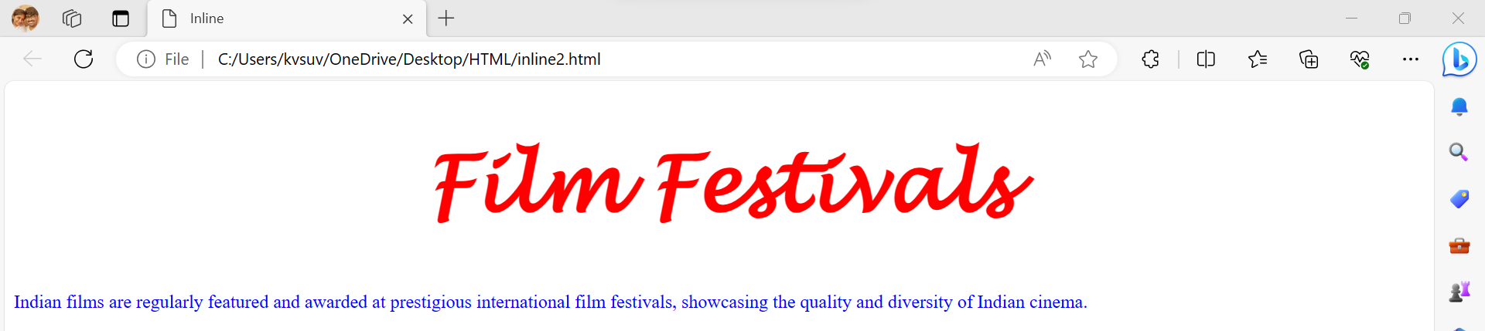
Inline Styles – Code 2 - Output

Slide 17
Document-Level (Internal) Style Sheets – Code1
<!DOCTYPE html>
<html>
<head>
<title>Document</title>
<style type=“text/css”>
h1{font-family : Lucida Handwriting; font-size : 50pt ; color : red ; text-align : center;}
</style>
</head>
<body>
<h1> Dayananda Sagar University </h1>
</body>
</html>

Slide 18
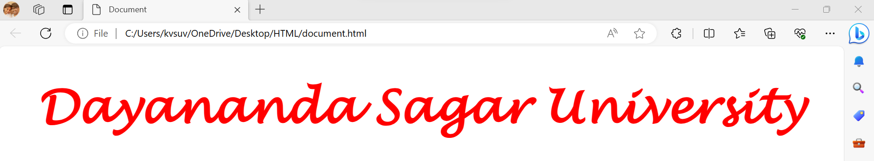
Document-Level (Internal) Style Sheets – Code1 - Output

Slide 19
Document-Level (Internal) Style Sheets – Code2
<!DOCTYPE html>
<html>
<head>
<title>Document2</title>
<style type=“text/css”>
body{background-color:Linen;}
h1{font-family:Georgia; font-size:25pt ; color:red ; text-align:center;}
p{font-family:Aptos; font-size:20pt ; color:purple ; text-align:left;}
</style> </head>
<body>
<h1> Longest Running Film </h1>
<p> "Dilwale Dulhania Le Jayenge" (DDLJ), a classic Bollywood film, holds the record for the longest continuous run in a single theater. It ran for over 20 years at Mumbai's Maratha Mandir cinema. </p>
</body>
</html>

Slide 20
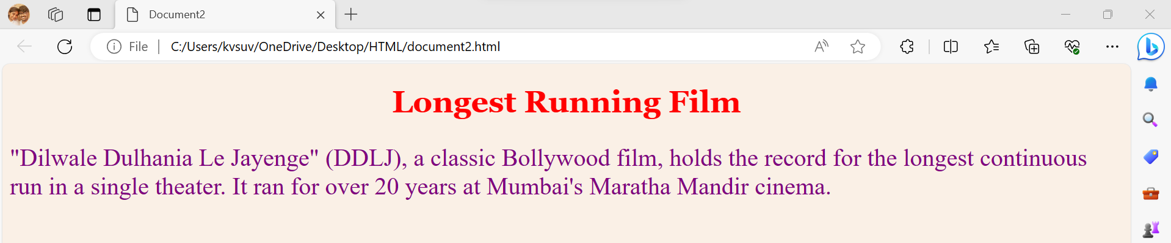
Document-Level (Internal) Style Sheets – Code2 - Output

Slide 21
External Style Sheets – Code1 - CSS
h1{font-family:Georgia; font-size:25pt ; color:red ; text-align:center;}
p{font-family:Aptos; font-size:20pt ; color:blue ; text-align:left;}

Slide 22
External Style Sheets – Code1 - HTML
<!DOCTYPE html>
<html>
<head>
<title>External1</title>
<link rel="stylesheet" href="external1.css">
</head>
<body>
<h1> Silent Film Pioneers </h1>
<p> India's first silent feature film, "Raja Harishchandra," was released in 1913 by Dadasaheb Phalke, often regarded as the father of Indian cinema. </p>
</body>
</html>

Slide 23
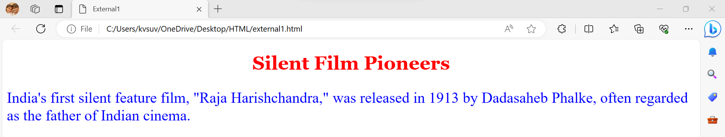
External Style Sheets – Code1 - Output

Slide 24
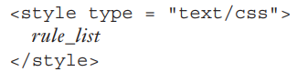
2. Style Specification Formats
Inline style specifications appear as values of the style attribute of a tag,4 the general form of which is as follows:
Document style specifications appear as the content of a style element within the header of a document, although the format of the specification is quite different from that of inline style sheets. The general form of the content of a style element is as follows:

Slide 25
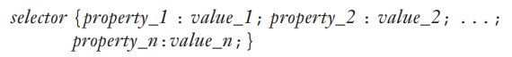
2. Style Specification Formats
External style: Each style rule in a rule list has two parts: a selector, which indicates the element or elements affected by the rule, and a list of property-value pairs. The list has the same form as the quoted list for inline style sheets, except that it is delimited by braces rather than double quotes. So, the form of a style rule is as follows:

Slide 26
3. Selector Forms
A selector specifies the elements to which the following style information applies.
Selector Forms
Simple Selector Forms
Class Selectors
Generic Selectors
id
Selectors
Contextual
Selectors
Pseudo
Classes
Universal Selector

Slide 27
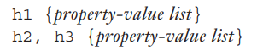
i. Simple Selector Forms
Here, the property values in the rule apply to all occurrences of the named element.
The selector could be a list of element names separated by commas, in which case the property values apply to all occurrences of all of the named elements.
The first of these selector forms specifies that the following property-value list applies to all h1 elements.
The second specifies that the following property-value list applies to all h2 and h3 elements

Slide 28
Simple Selector Forms – code1
<!DOCTYPE html>
<html>
<head>
<title>Simple Selector</title>
<style type="text/css">
h1 {font-family : Lucida Handwriting; font-size : 50pt ; color : red ; text-align : center;}
h2, h3 {font-family : Verdana; font-size : 30pt ; color : green ; text-align : left;}
</style>
</head>
<body>
<h1> My Favourite Books </h1>
<h2> Pride and Prejudice </h2>
<h3> Gone with the Wind </h3>
</body>
</html>

Slide 29
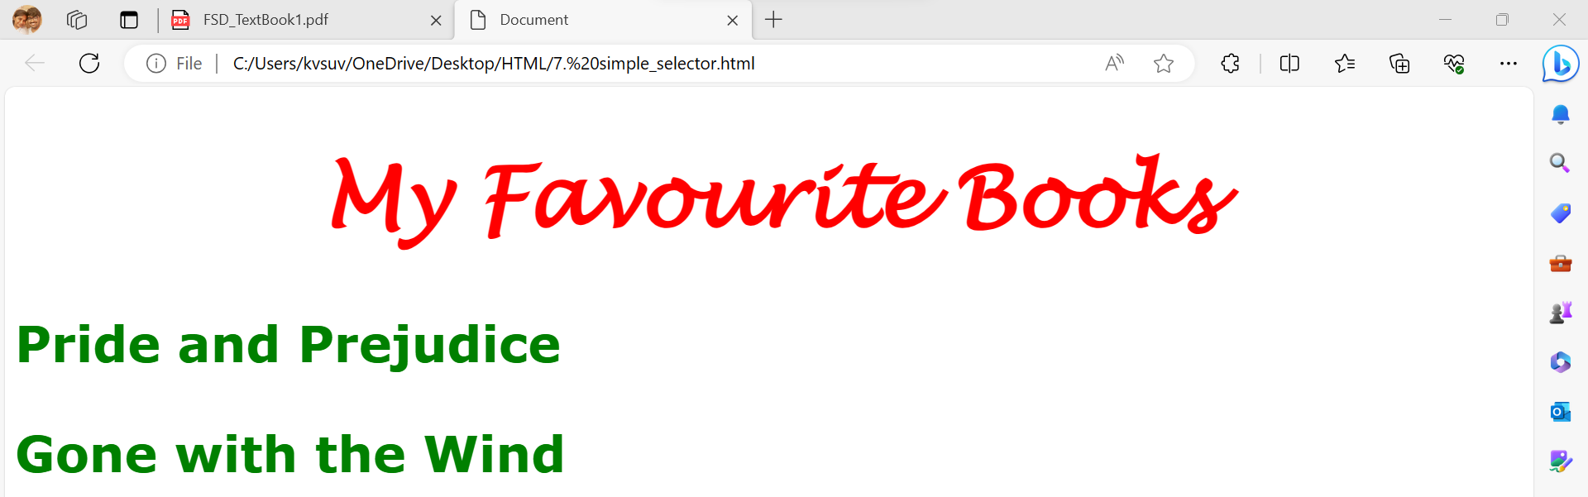
Simple Selector Forms – code1 - output

Slide 30
ii. Class Selectors
Class selectors are used to allow different occurrences of the same tag to use different style specifications.
A style class is defined in a style element by giving the style class a name, which is attached to the tag’s name with a period.
For example, if you want two paragraph styles in a document—say, normal and warning—you could define these two classes in the content of a style element as follows:
p.normal {property-value list}
p.warning {property-value list}

Slide 31
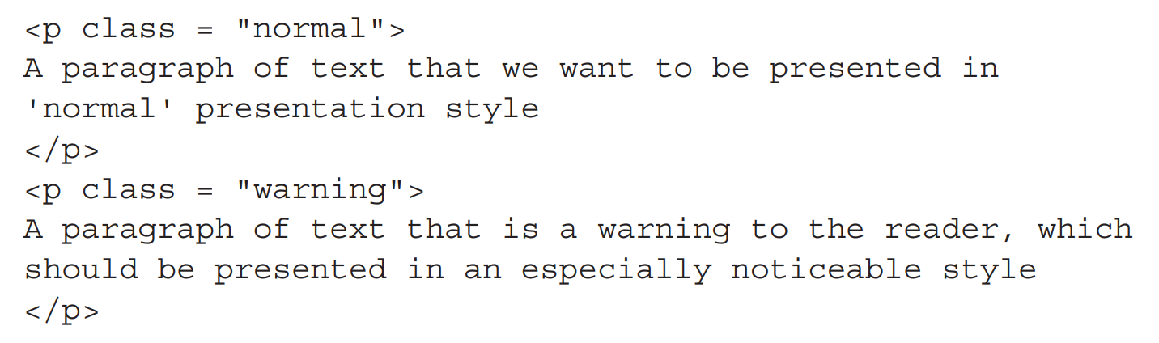
Class Selectors
Within the document body, the particular style class that you want is specified with the class attribute of the affected tag.

Slide 32
Class Selectors - Code
<!DOCTYPE html>
<html>
<head>
<title>Class Selector</title>
<style type="text/css">
h1.one{font-size : 50pt ; color : red ; text-align : center;}
h1.two{font-size : 30pt ; color : green ; text-align : left;}
</style> </head>
<body>
<h1 class="one"> My Favourite Series </h1>
<h1 class="two"> Friends </h1>
<h1 class=“one"> Breaking Bad </h1>
</body>
</html>

Slide 33
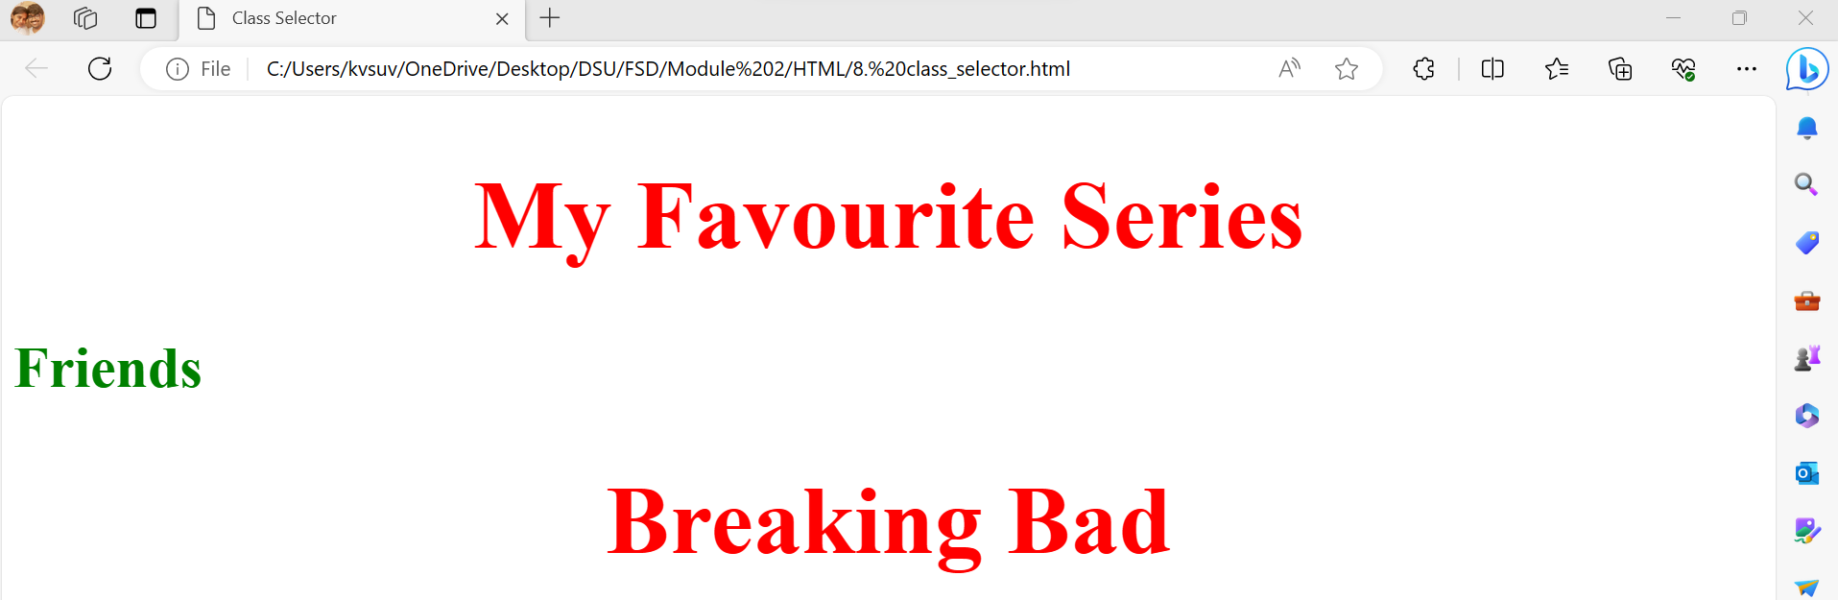
Class Selectors – Code - Output

Slide 34
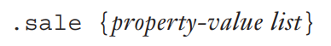
iii. Generic Selectors
It is convenient to have a class of style specifications that applies to the content of more than one kind of tag.
It is defined without a tag name in its selector.
Without the tag name, the name of the generic class begins with a period.

Slide 35
Generic Selectors - code
<!DOCTYPE html>
<html>
<head>
<title>Simple Selector</title>
<style type="text/css">
.one{font-family: Monotype Corsiva; font-size : 50pt ; color : red ; text-align : center;}
</style> </head>
<body>
<h1 class="one"> My Favourite Anime </h1>
<p class="one"> Naruto </p>
<h6 class="one"> One Piece </h6>
</body>
</html>

Slide 36
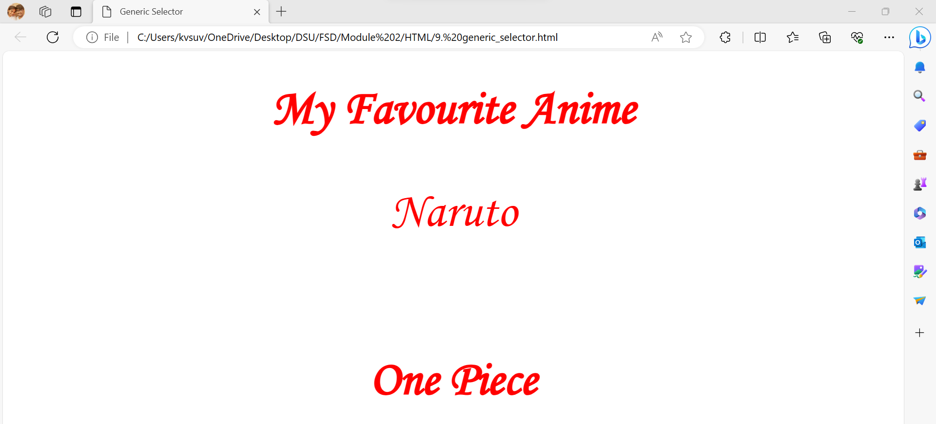
Generic Selectors – code - Output

Slide 37
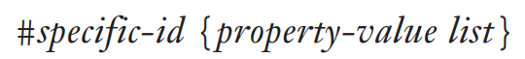
iv. id Selectors
An id selector allows the application of a style to one specific element. The general form of an id selector is as follows:
the style specified in the id selector applies to the element with the given id.
Following is the h2 element to which this style applies:

Slide 38
id Selectors - Code
<!DOCTYPE html>
<html>
<head>
<title>Simple Selector</title>
<style type="text/css">
#one{font-family: Monotype Corsiva; font-size : 50pt ; color : red ; text-align : center;}
#two{font-family: Monotype Corsiva; font-size : 30pt ; color : blue ; text-align : left;}
</style> </head>
<body>
<h1 id="one"> My Favourite Anime </h1>
<p id="two"> Naruto is my favourite </p>
</body>
</html>

Slide 39
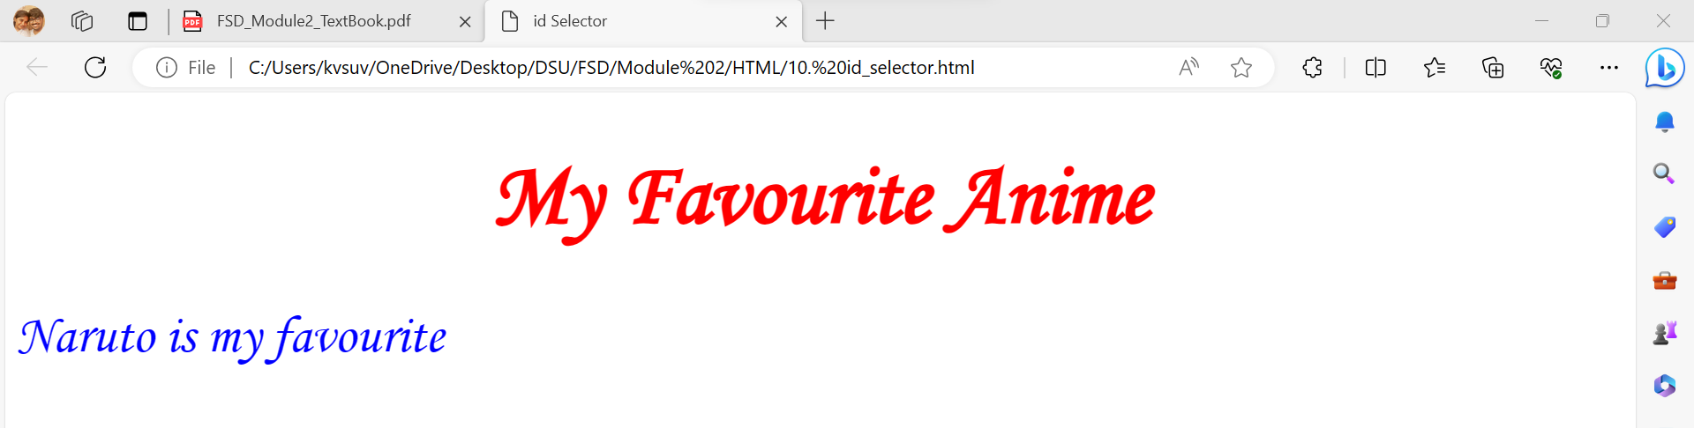
id Selectors – Code - Output

Slide 40
v. Contextual Selectors
A contextual selector is defined as a selector which considers the context where the style is to be applied.
In simple words, the specified style is applied to an element only if the element is in the specified context.
Context can be defined as a parent/child relationship or ancestor/descendant relationship between different parts of the document.
A contextual selector is made up of two or more simple selectors separated by white space.
Contextual selector also known as element-element selector or space selectors.

Slide 41
Contextual Selectors – Code1
<!DOCTYPE html>
<html>
<head>
<title>Contextual Selectors1</title>
<style type="text/css">
div {color: red; font-size : 50pt}
p {color: green; font-size : 30pt}
</style> </head>
<body>
<div>
<p>Full Stack Development</p>
<p>Module 1: HTML</p>
</div>
<p>Module 2: CSS</p>
</body>
</html>

Slide 42
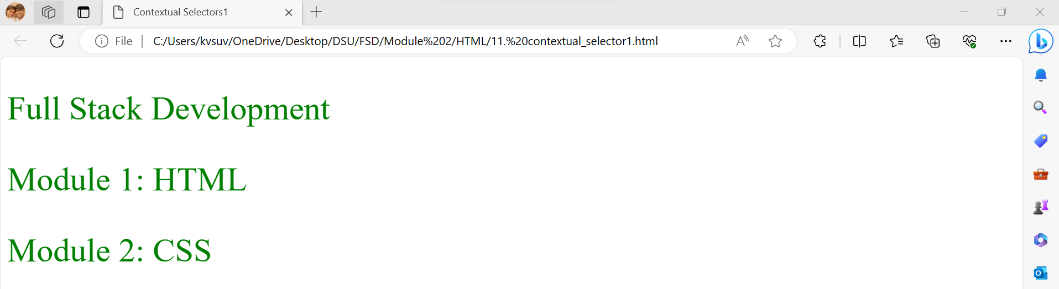
Contextual Selectors – Code1 - Output

Slide 43
Contextual Selectors – Code2
<!DOCTYPE html>
<html>
<head>
<title>Contextual Selectors2</title>
<style type="text/css">
div p{color: red; font-size : 50pt;}
p {color: green; font-size : 30pt;}
</style> </head>
<body>
<div>
<p>Full Stack Development</p>
<p>Module 1: HTML</p>
</div>
<p>Module 2: CSS</p>
</body>
</html>

Slide 44
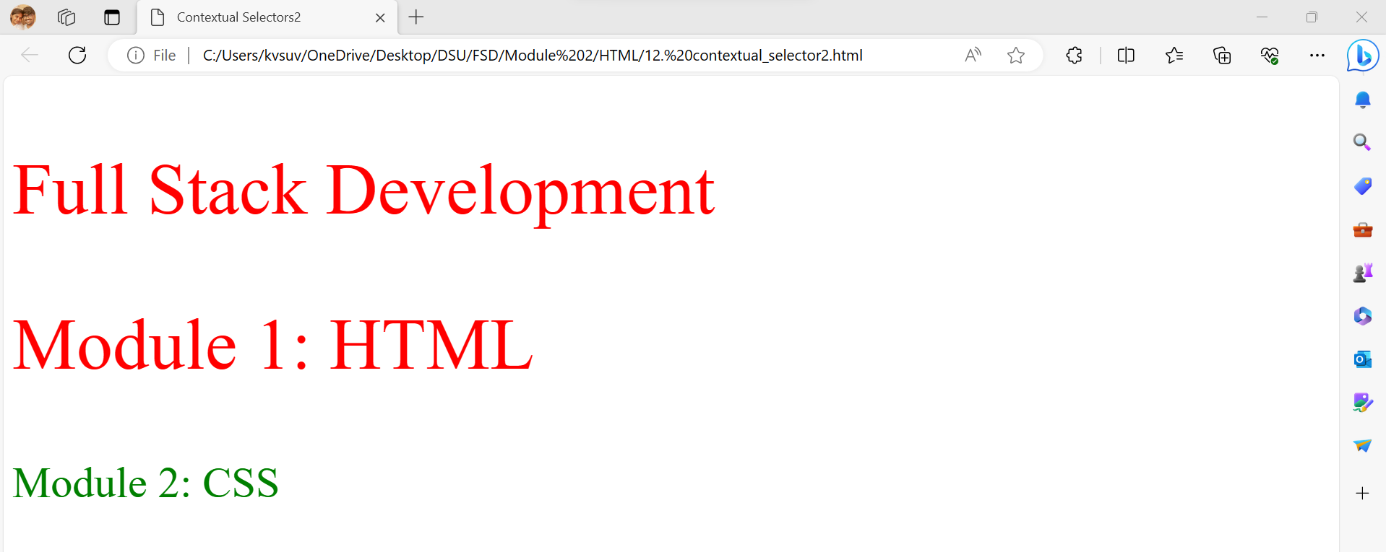
Contextual Selectors – Code2 - Output

Slide 45
Contextual Selectors – Code3
<!DOCTYPE html>
<html>
<head>
<title>Contextual Selectors3</title>
<style type="text/css">
div > p{color: red; font-size : 50pt}
</style> </head>
<body>
<div>
<p>Full Stack Development</p>
</div>
<div>
<span><p>Module 2: CSS</p></span>
</div>
</body>
</html>
Element > Element
It is used to select elements with a specific parent.
Elements that are not directly a child of the specified parent, are not selected.

Slide 46
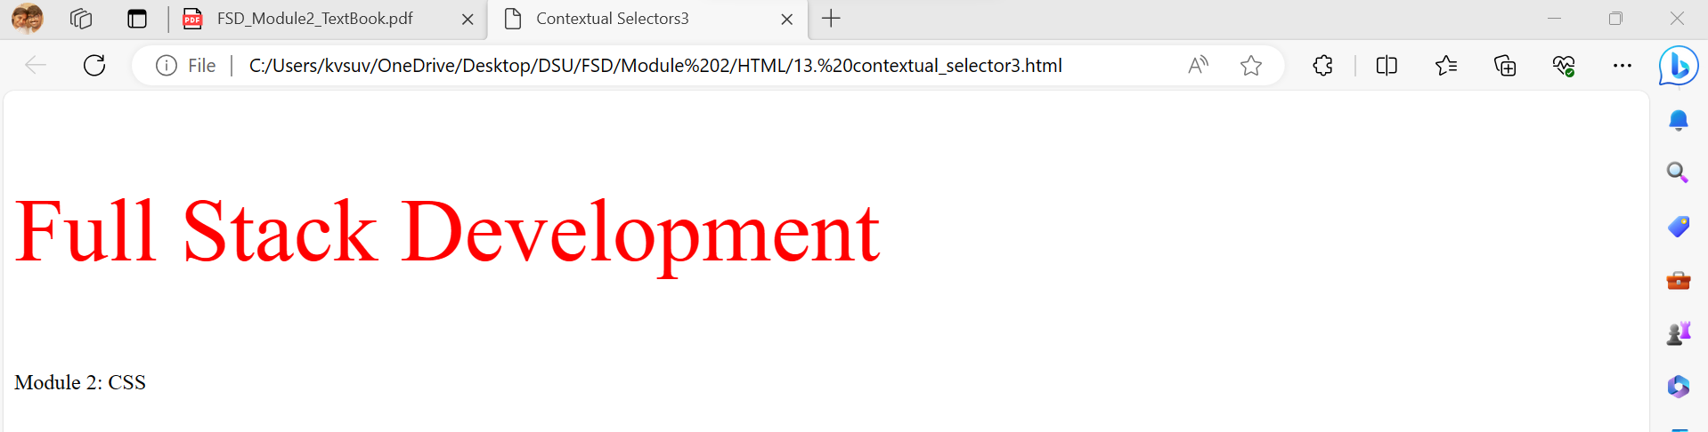
Contextual Selectors – Code3 - Output

Slide 47
Contextual Selectors – Code4
p:first-child {property-value list}
The properties in the list are applied to the first child element of each p element.
p:last-child {property-value list}
The properties in the list are applied to the last child element of each p element.
p:only-child {property-value list}
The properties in the list are applied to the child element of each p element that has just one child element.
p:empty {property-value list}
The properties in the list are applied to each p element that has no child elements.

Slide 48
Contextual Selectors – Code4
<!DOCTYPE html>
<html>
<head>
<title>Contextual Selectors4</title>
<style type="text/css">
p:first-child {background-color: red; font-size: 40pt}
p:last-child {background-color: yellow; font-size: 40 pt}
</style> </head>
<body>
<div>
<p> Full Stack Development </p>
<p> Module 1: HTML </p>
<p> Module 2: CSS </p>
</div>
<p> Full Stack Development </p>
<p> Module 1: HTML </p>
</body>
</html>

Slide 49
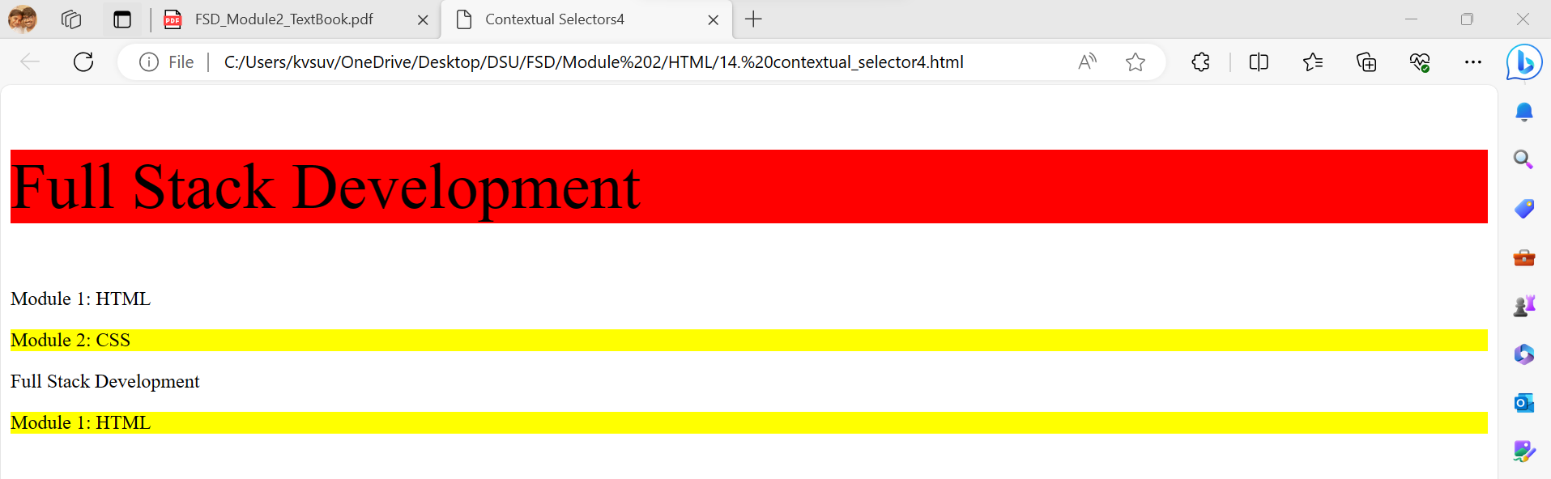
Contextual Selectors – Code4 - Output

Slide 50
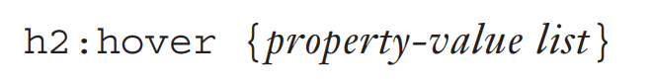
vi. Pseudo Classes
Pseudo classes specify that certain styles apply when something happens, rather than because the target element simply exists.
Pseudo class selectors are used if properties are to be changed dynamically .
Example: When mouse movement happens ,in other words hover happens or focus happens.
The names of pseudo classes begin with a colon.

Slide 51
Pseudo Classes
Pseudo Classes
Style Hypertext links
Style any element
link
visited
hover
focus

Slide 52
Pseudo Classes – Style hypertext links
The link pseudo class is used to style a link that has not been selected.
The visited pseudo class is used to style a link that previously has been selected.
Pseudo Classes – Style any element
The style of the hover pseudo class applies when its associated element has the mouse cursor over it.
The style of the focus pseudo class applies when its associated element has focus. {active}

Slide 53
Pseudo Classes – Code1
<!DOCTYPE html>
<html>
<head>
<style type=“text/css”>
a:link {color: red; font-size: 50pt;}
a:visited {color: green; font-size: 50pt;}
a:hover {color: hotpink; font-size: 50pt;}
a:focus {color: blue; font-size: 50pt;}
</style> </head>
<body>
<a href="https://www.google.com"> Google </a> <br>
<a href="https://www.gmail.com"> Gmail </a> <br>
<a href="https://www.fb.com"> FB </a>
</body>
</html>

Slide 54
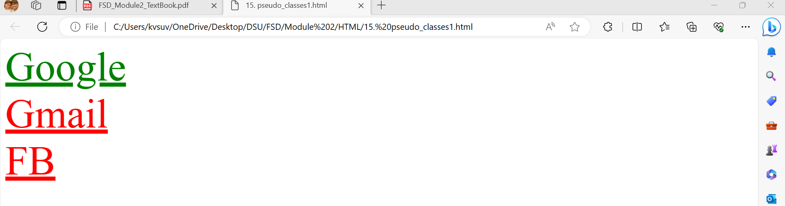
Pseudo Classes – Code1 - Output

Slide 55
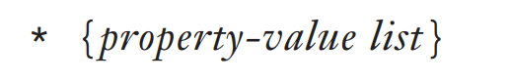
vii. Universal Selector
The universal selector, denoted by an asterisk (*), applies its style to all elements in a document.
For every element in a document to have a particular set of properties, we could include the following:

Slide 56
Universal Selector - Code
<!DOCTYPE html>
<html>
<head>
<title>Universal Selector</title>
<style type="text/css">
*{color: purple;font-size: 50pt;}
</style>
</head>
<body>
<h1>National Award Winners</h1>
<ul>
<li>Rakshith Shetty</li>
<li>Allu Arjun</li>
<li>Kriti Sanon</li>
<li>Alia Bhatt</li>
</ul>
</body>
</html>

Slide 57
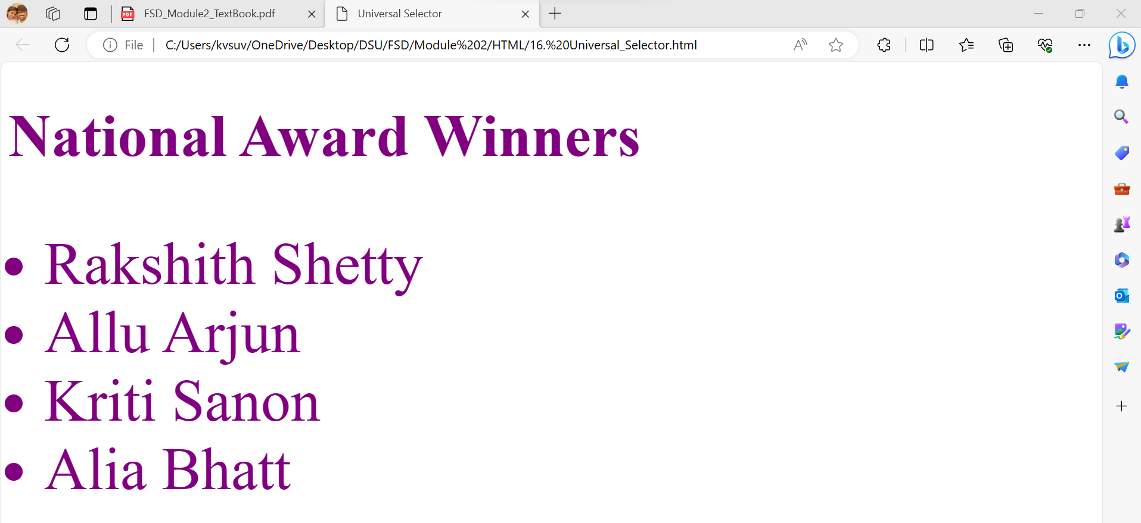
Universal Selector – Code - Output

Slide 58
4. Property Value Forms
CSS includes a large number of different properties, arranged in categories.
The most commonly used categories are: fonts, lists, alignment of text, margins, colors, backgrounds, and borders.

Slide 59
Property Value Forms
font-size
Keyword property values are used when there are only a few possible values and they are predefined—for example, large, medium, and small.
Keyword values are not case sensitive, so Small, SmAlL, and SMALL are all the same as small.

Slide 60
Property Value Forms
Image – width and height
Number values are used when no meaningful units can be attached to a numeric property value.
A number value can be either an integer or a sequence of digits with a decimal point and can be preceded by a sign (+ or -).

Slide 61
Property Value Forms
Length
Length values are specified as number values that are followed immediately by a two-character abbreviation of a unit name.
There can be no space between the number and the unit name.
The possible unit names are px, for pixels; in, for inches; cm, for centimeters; mm, for millimeters; pt, for points (a point is 1/72 inch); and pc, for picas, which are 12 points.

Slide 62
Property Value Forms
Relative Length
em → which is the value of the current font size in pixels.
ex → which is the height of the letter x.

Slide 63
Property Value Forms
Percentage Values
Percentage values are used to provide a measure that is relative to the previously used measure for a property value.
Percentage values are numbers that are followed immediately by a percent sign (%)
Ex: Font size were set to 75% with a style sheet, it would make the new current size for the font 75 percent of its previous value.
Percentage values can be signed. If preceded by a plus sign, the percentage is added to the previous value; if negative, the percentage is subtracted.

Slide 64
Property Value Forms
Color Property
Color property values can be specified as color names, as six-digit hexadecimal numbers, or in RGB form.
RGB form is just the word rgb followed by a parenthesized list of three decimal numbers in the range of 0 to 255 or three percentage values.
These numbers or percentages specify the levels of red, green, and blue, respectively.
Hexadecimal numbers must be preceded with pound signs (#), as in #43AF00.

Slide 65
Property Value Forms
URL Property
URL property values use a form that is slightly different from references to URLs in links.
The actual URL, which can be either absolute or relative, is placed in parentheses and preceded by url.

Slide 66
5. Font Properties
Font Families
Font Sizes
Font Variants
Font Styles
Font Weights
Font Shorthands
Text
Decoration
Text Spacing

Slide 67
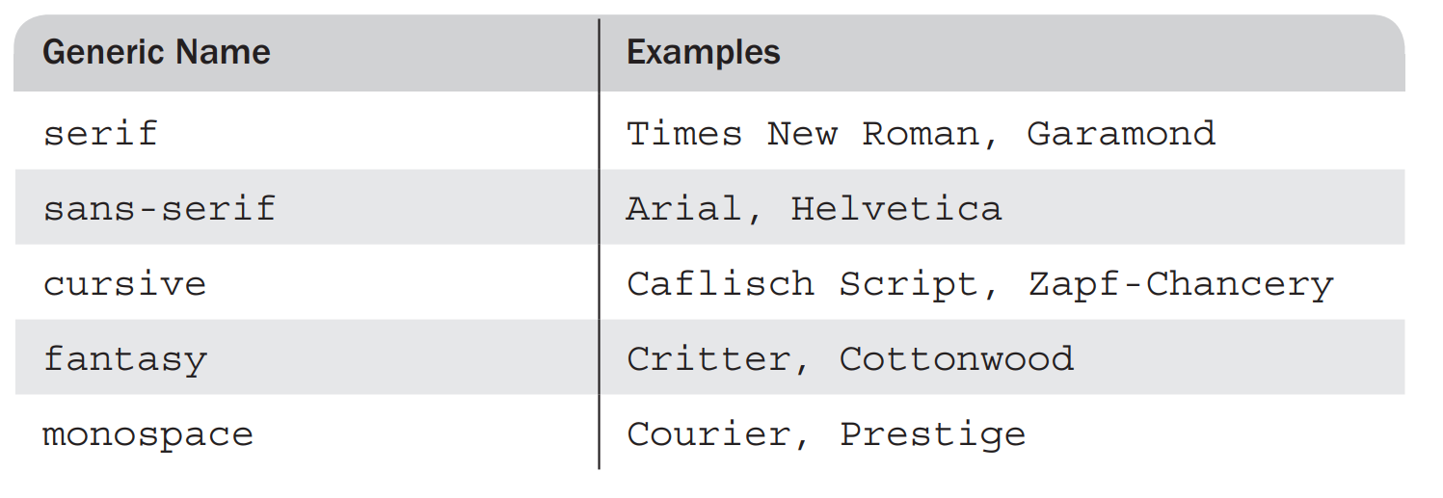
i. Font Families
The font-family property is used to specify a list of font names.
The browser uses the first font in the list that it supports.
Ex: font-family: Arial, Helvetica, Futura
A generic font can be specified as a font-family value.
If a font name has more than one word, the whole name should be delimited by single quotes.
Ex: font-family: 'Times New Roman’ {Recommended}

Slide 68
Font Families - Code
<!DOCTYPE html>
<html>
<head>
<title>Font Families</title>
<style type="text/css">
div p{font-family: 'Times New Roman';font-size: 30pt;}
p{font-family: monospace;font-size: 50pt;}
</style>
</head>
<body>
<p>National Award Winners</p>
<div>
<p>Rakshith Shetty</p>
<p>Allu Arjun</p>
</div>
<p>Kriti Sanon</p>
<p>Alia Bhatt</p>
</body>
</html>

Slide 69

Font Families – Code - Output

Slide 70
ii. Font Sizes
The font-size property specifies the size of the font.
Absolute: the size value could be given as a length value in points, picas, or pixels, or as a keyword from the list: xx-small, x-small, small, medium, large, x-large, and xx-large.
Relative: The relative size values are smaller and larger, which adjust the font size relative to the font size of the parent element.
Problem with the keyword sizes is that the size relationship between adjacent keywords is not exactly the same on different browsers.

Slide 71
Font Sizes - Code
<!DOCTYPE html>
<html>
<head>
<title>Font Sizes</title>
<style type="text/css">
div p{font-family: 'Times New Roman';font-size: small;}
p{font-family: monospace;font-size: 50%;}
</style>
</head>
<body>
<p>National Award Winners</p>
<div>
<p>Rakshith Shetty</p>
<p>Allu Arjun</p>
</div>
<p>Kriti Sanon</p>
<p>Alia Bhatt</p>
</body>
</html>

Slide 72
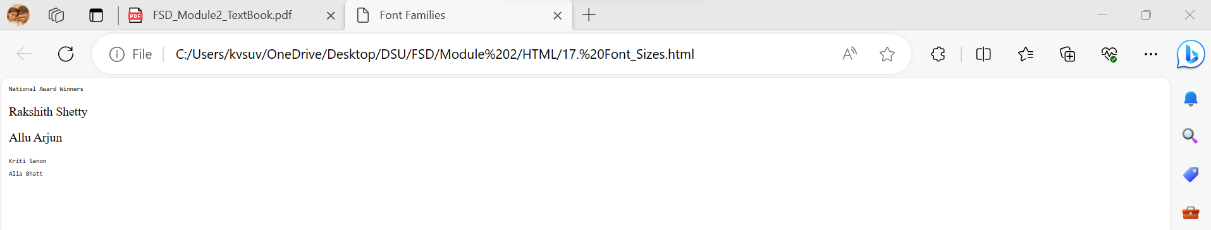
Font Sizes – Code - Output

Slide 73
iii. Font Variants
The default value of the font-variant property is normal, which specifies the usual character font.
This property can be set to small-caps to specify small capital letters.
These are all uppercase, but the letters that are normally uppercase are a bit larger than those that are normally lowercase.

Slide 74
Font Variants - Code
<!DOCTYPE html>
<html>
<head>
<title>Font Variants</title>
<style type="text/css">
div p{font-size: 30pt;}
p{font-size: 30pt; font-variant: small-caps;}
</style>
</head>
<body>
<p>National Award Winners</p>
<div>
<p>RAKSHITH SHETTY</p>
<p>ALLU ARJUN</p>
</div>
<p>Kriti Sanon</p>
<p>Alia Bhatt</p>
</body>
</html>

Slide 75
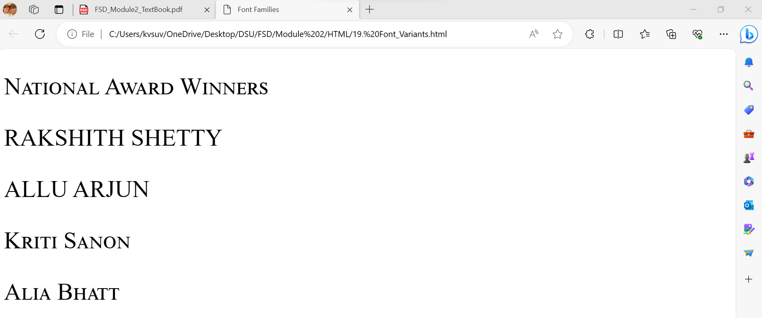
Font Variants – Code - Output

Slide 76
iv. Font Styles
The font-style property is usually used to specify italic:
font-style: italic
oblique: value is almost similar to italic.
normal: value specifies the font to be normal style.

Slide 77
Font Styles - Code
<!DOCTYPE html>
<html>
<head>
<title>Font Styles</title>
<style type="text/css">
h2{color: red; font-style: oblique;}
p{font-size: 30pt; font-style: italic;}
</style>
</head>
<body>
<h2>National Award Winners - MUSIC</h2>
<p>DEVI SRI PRASAD</p>
<p>KALA BHAIRAVA</p>
<p>SHREYA GHOSHAL</p>
</body>
</html>

Slide 78
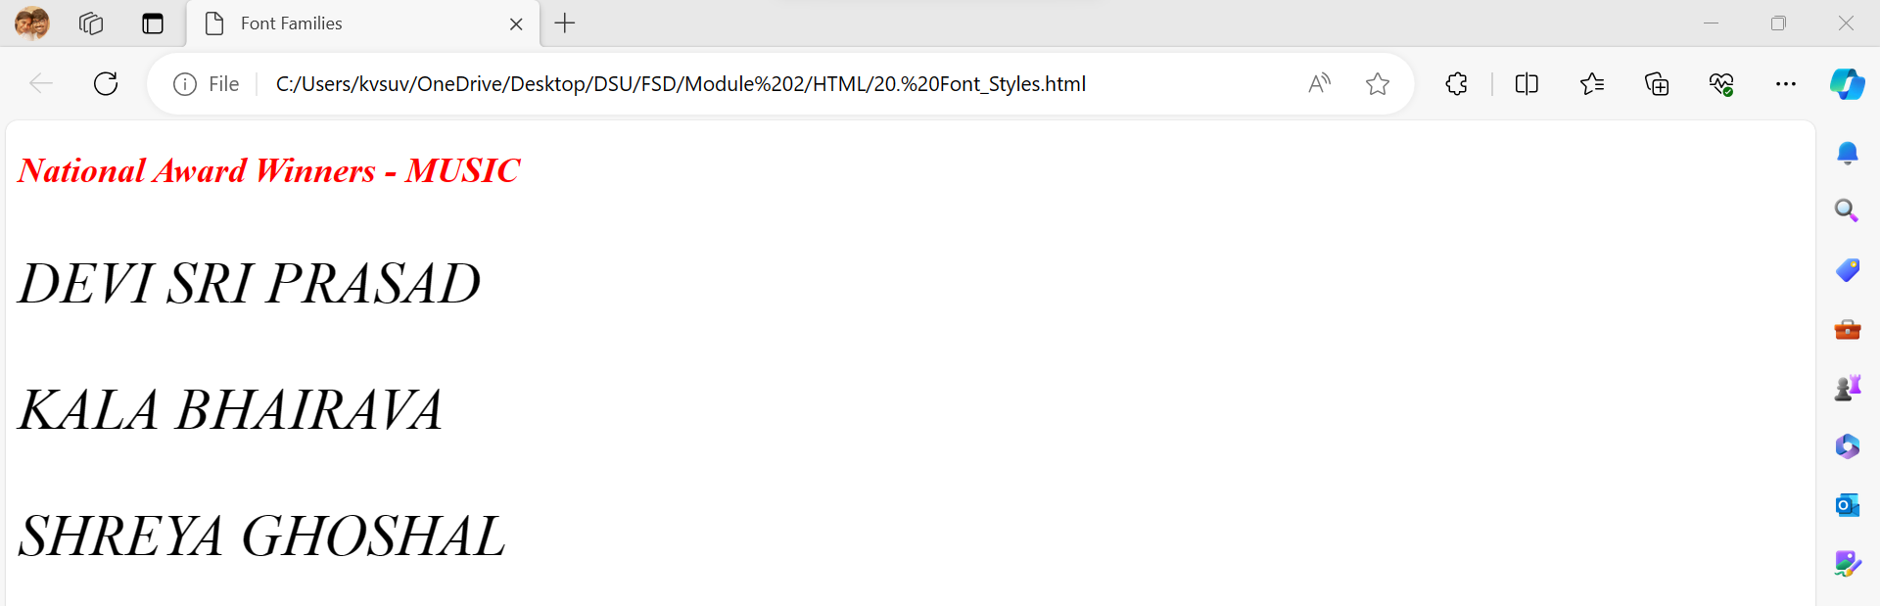
Font Styles – Code – Output

Slide 79
v. Font Weights
The font-weight property is used to specify the degree of boldness: font-weight: bold
Besides bold:
normal (default)
bolder
lighter
Specific numbers also can be given in multiples of 100 from 100 to 900, where 400 is the same as normal and 700 is the same as bold.

Slide 80
Font Weights - Code
<!DOCTYPE html>
<html>
<head>
<title>Font Weights</title>
<style type="text/css">
h1{color: blue; font-weight: lighter;}
h2{color: red; font-weight: bold;}
p{font-size: 30pt; font-weight: bolder;}
</style>
</head>
<body>
<h1>2023 Awards</h1>
<h2>National Award Winners - MUSIC</h2>
<p>DEVI SRI PRASAD</p>
<p>KALA BHAIRAVA</p>
<p>SHREYA GHOSHAL</p>
</body>
</html>

Slide 81
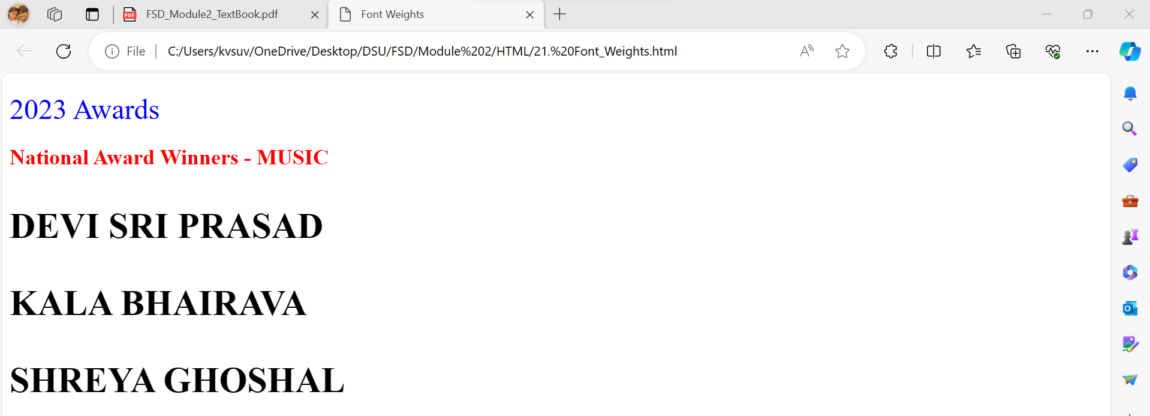
Font Weights – Code - Output

Slide 82
vi. Font Shorthands
If more than one font property must be specified, the values can be stated in a list as the value of the font property.
The browser then determines which properties to assign from the forms of the values.
font: bold 1.1em 'Times New Roman' Palatino
The above property specifies that the font weight should be bold, the font size {second to last} should be 1.1 times that of its parent element, and either Times New Roman or Palatino font name {last} should be used, with precedence given to Times New Roman.

Slide 83
Font Shorthands - Code
<!DOCTYPE html>
<html>
<head>
<title>Font Shorthands</title>
<style type="text/css">
h2{color: red;}
p{font: bolder 32px 'Open Sans', sans-serif;}
</style>
</head>
<body>
<h2>National Award Winners - MUSIC</h2>
<p>DEVI SRI PRASAD</p>
<p>KALA BHAIRAVA</p>
<p>SHREYA GHOSHAL</p>
</body>
</html>

Slide 84
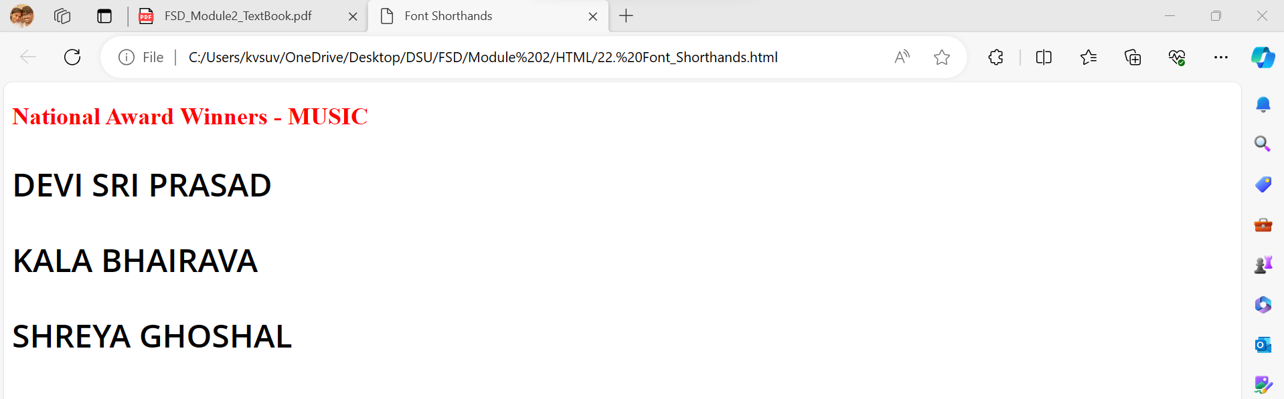
Font Shorthands – Code - Output

Slide 85
vii. Text Decoration
The text-decoration property is used to specify some special features of text.
The available values are line-through, overline, underline, and none, which is the default. Many browsers implicitly underline links.
The none value can be used to avoid this underlining.

Slide 86
Text Decoration - Code
<!DOCTYPE html>
<html>
<head>
<title>Text Decoration</title>
<style type="text/css">
p.one{font-size: 50pt; color: red ; text-decoration: line-through;}
p.two{font-size: 30pt; color: green ; text-decoration: underline;}
p.three{font-size: 30pt; color: purple ; text-decoration: overline;}
</style>
</head>
<body>
<p class="one"> My Favourite Series </p>
<p class="two"> Friends </p>
<p class="three"> Breaking Bad </p>
</body>
</html>

Slide 87
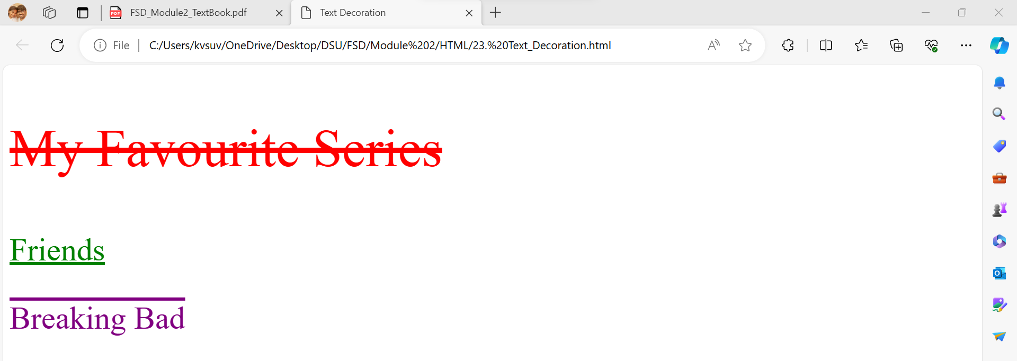
Text Decoration – Code - Output

Slide 88
viii. Text Spacing
Text Spacing
letter-spacing
(Tracking)
word-spacing
line-height
(Leading)
letter-spacing: 1px
Spreads the letters
letter-spacing: -1px
Squeezes the letters
word-spacing: 1px
Spreads the words
word-spacing: -1px
Squeezes the words
line-height: 24px

Slide 89
Text Spacing - Code
<!DOCTYPE html>
<html>
<head>
<title>Text Spacing</title>
<style type="text/css">
p.one{font-size: 50pt; color: red ; letter-spacing: 2px;}
p.two{font-size: 30pt; color: green ; letter-spacing: -2px;}
p.three{font-size: 30pt; color: purple ; word-spacing: 2px;}
p.four{font-size: 30pt; color: blue ; word-spacing: -2px;}
p.five{font-size: 30pt; color: grey ; line-height: 24px;}
</style>
</head>
<body>
<p class="one"> My Favourite Series </p>
<p class="two"> Friends: Chandler is best.</p>
<p class="three"> Breaking Bad: I know a guy who knows a guy.</p>
<p class="four"> Suits: You always have a choice.</p>
<p class="five"> Game of Thrones: Winter is coming.<br>House of Dragons Season 2 coming soon</p>
</body>
</html>

Slide 90

Text Spacing – Code - Output

Slide 91
6. List Properties
Two presentation details of lists can be specified in HTML documents: the shape of the bullets that precede the items in an unordered list and the sequencing values that precede the items in an ordered list.
The list-style-type property is used to specify both of these.
If list-style-type is set for a ul or an ol tag, it applies to all of the list items in the list.
If a list-style-type is set for an li tag, it only applies to that list item.
The list-style-type property of an unordered list can be set to disc (the default), circle, square, or none.
A disc is a small filled circle, a circle is an unfilled circle, and a square is a filled square.

Slide 92
Unordered List – Code1
<!DOCTYPE html>
<html>
<head>
<title>Unordered List1</title>
<style type="text/css">
ul{font-size: 30pt; color: red;}
</style>
</head>
<body>
<h1>Programming languages</h1>
<ul>
<li>C</li>
<li>C++</li>
<li>Java</li>
<li>Python</li>
</ul>
</body>
</html>
By Default, disc – bullet is considered for unordered list

Slide 93
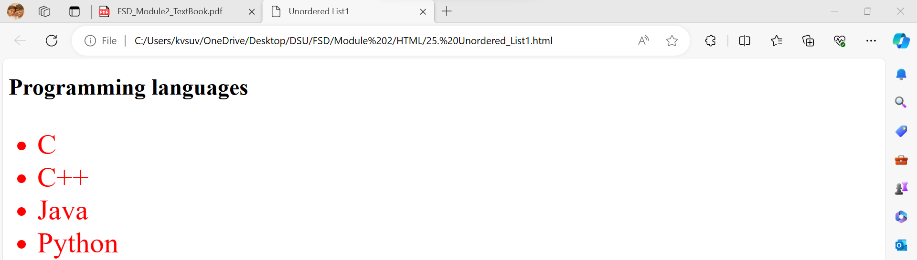
Unordered List – Code1 - Output

Slide 94
Unordered List – Code2
<!DOCTYPE html>
<html>
<head>
<title>Unordered List2</title>
<style type="text/css">
ul{font-size: 30pt; color: blue; list-style-type: square;}
</style>
</head>
<body>
<h1>Programming languages</h1>
<ul>
<li>C</li>
<li>C++</li>
<li>Java</li>
<li>Python</li>
</ul>
</body>
</html>
Here, list-style-type is square.

Slide 95
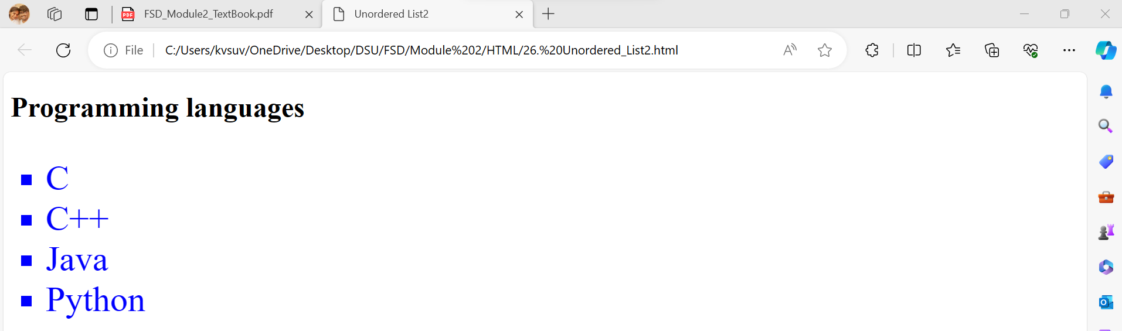
Unordered List – Code2 - Output

Slide 96
Unordered List – Code3
<!DOCTYPE html>
<html>
<head>
<title>Unordered List3</title>
<style type="text/css">
ul{font-size: 30pt; color: blue; list-style-type: circle;}
</style>
</head>
<body>
<h1>Programming languages</h1>
<ul>
<li>C</li>
<li>C++</li>
<li>Java</li>
<li>Python</li>
</ul>
</body>
</html>
Here, list-style-type is circle.

Slide 97
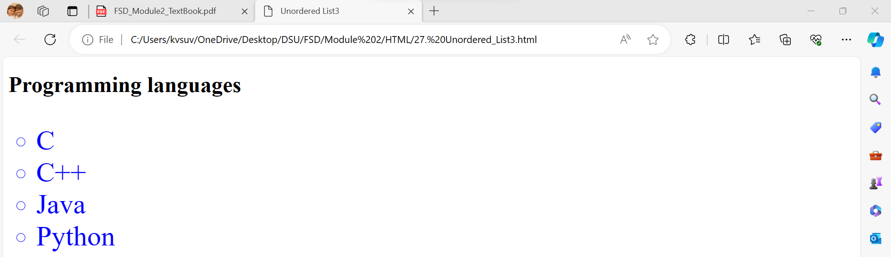
Unordered List – Code3 - Output

Slide 98
Unordered List – Code4
<!DOCTYPE html>
<html>
<head>
<title>Unordered List4</title>
<style type="text/css">
li.one{font-size: 30pt; color: blue;}
li.two{font-size: 30pt; color: red; list-style-type: circle;}
li.three{font-size: 30pt; color: green; list-style-type: square;}
li.four{font-size: 30pt; color: purple; list-style-type: none;}
</style>
</head>
<body>
<h1>Programming languages</h1>
<ul>
<li class="one">C</li>
<li class="two">C++</li>
<li class="three">Java</li>
<li class="four">Python</li>
</ul>
</body>
</html>
Here, list-style-type is given for individual items.

Slide 99
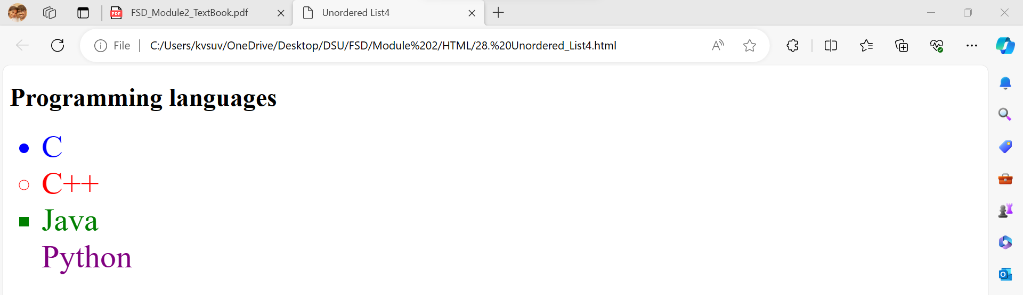
Unordered List – Code4 - Output

Slide 100
Unordered List – Code5
<!DOCTYPE html>
<html>
<head>
<title>Unordered List5</title>
<style type="text/css">
li.one{font-size: 20pt; list-style-image: url(one.png);}
li.two{font-size: 20pt; list-style-image: url(two.png);}
li.three{font-size: 20pt; list-style-image: url(three.png);}
li.four{font-size: 20pt; list-style-image: url(four.png);}
</style>
</head>
<body>
<h1>Programming languages</h1>
<ul>
<li class="one">C</li>
<li class="two">C++</li>
<li class="three">Java</li>
<li class="four">Python</li>
</ul>
</body>
</html>
Here, list-style-image property is used.

Slide 101
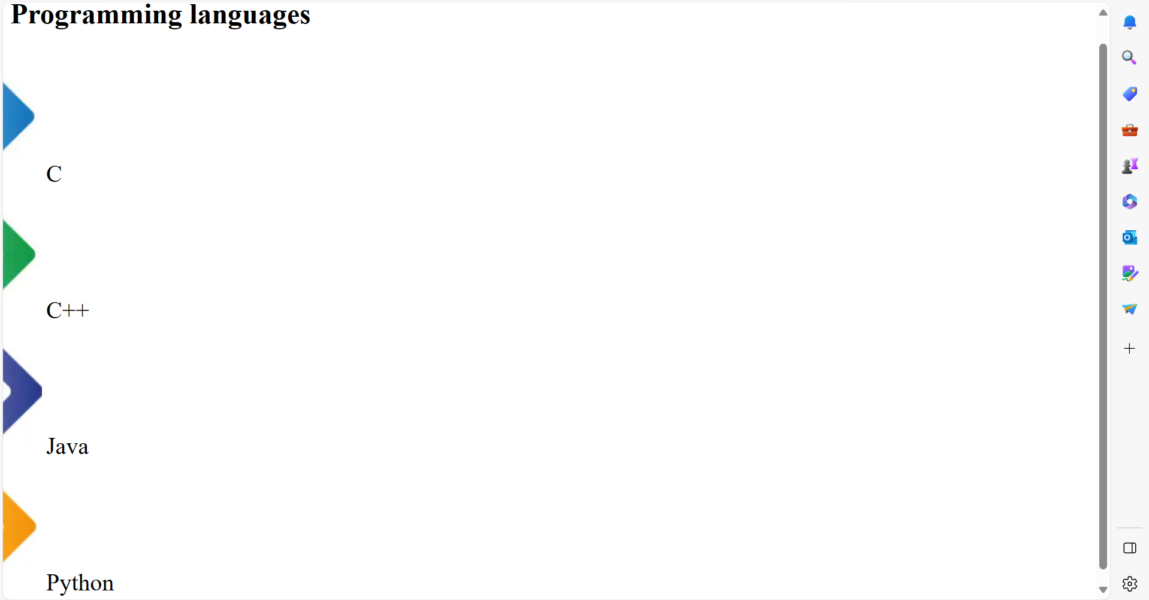
Unordered List – Code5 - Output

Slide 102
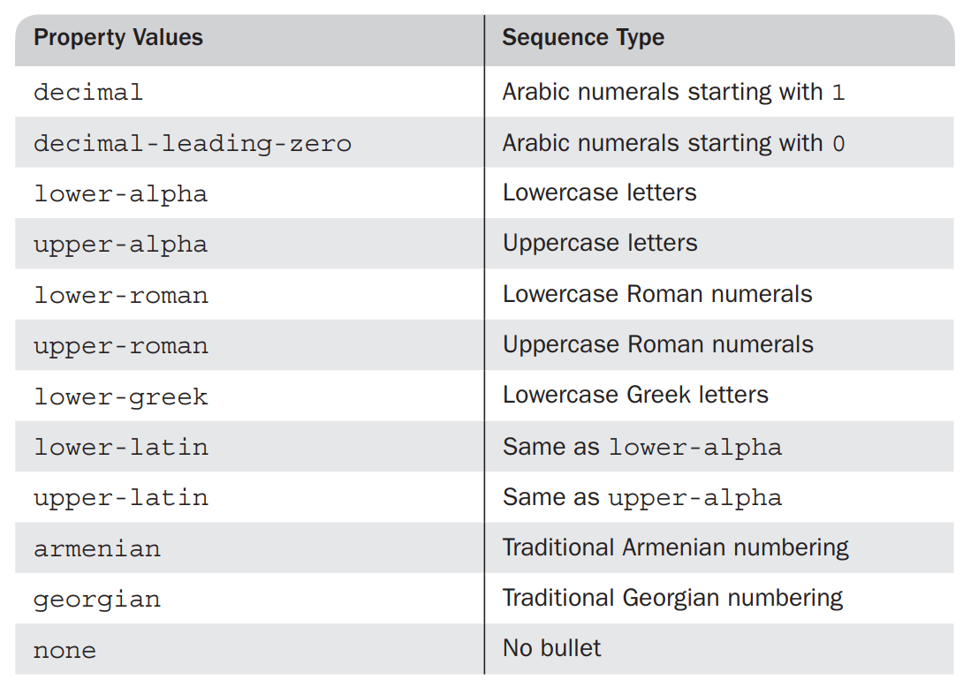
Ordered List
The list-style-type property can be used to specify the types of sequence values.

Slide 103
Ordered List – Code1
<!DOCTYPE html>
<html>
<head>
<title>Ordered List1</title>
<style type="text/css">
ul{font-size: 30pt; color: red;}
</style>
</head>
<body>
<h1>Programming languages</h1>
<ol>
<li>C</li>
<li>C++</li>
<li>Java</li>
<li>Python</li>
</ol>
</body>
</html>
By Default, numbers from 1 is considered for ordered list

Slide 104
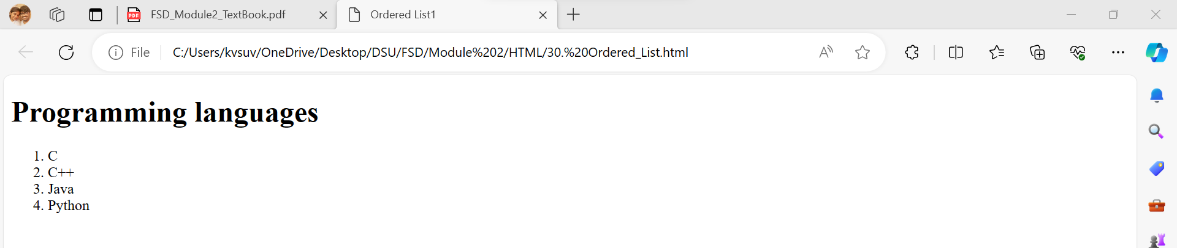
Ordered List – Code1 - Output

Slide 105
Ordered List – Code2
<!DOCTYPE html>
<html>
<head>
<title>Ordered List2</title>
<style type="text/css">
li{font-size: 30pt; color: blue; list-style-type: upper-alpha;}
</style>
</head>
<body>
<h1>Programming languages</h1>
<ol>
<li>C</li>
<li>C++</li>
<li>Java</li>
<li>Python</li>
</ol>
</body>
</html>

Slide 106
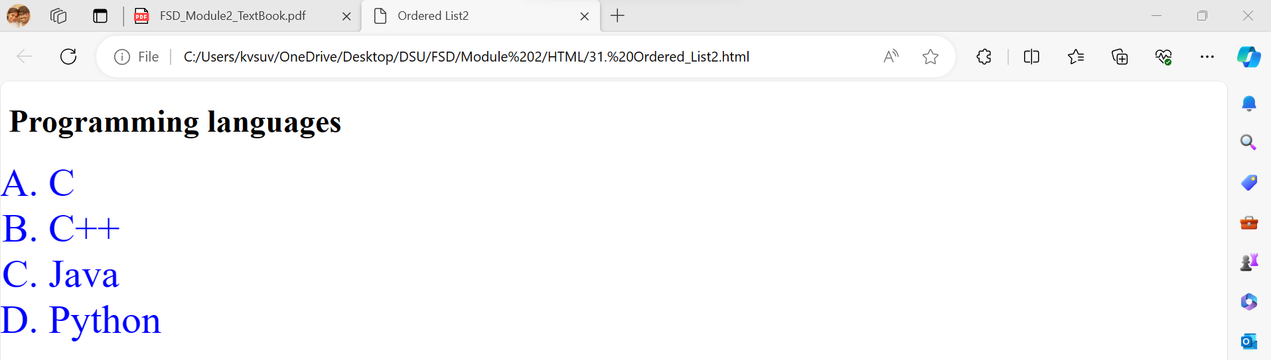
Ordered List – Code2 - Output

Slide 107
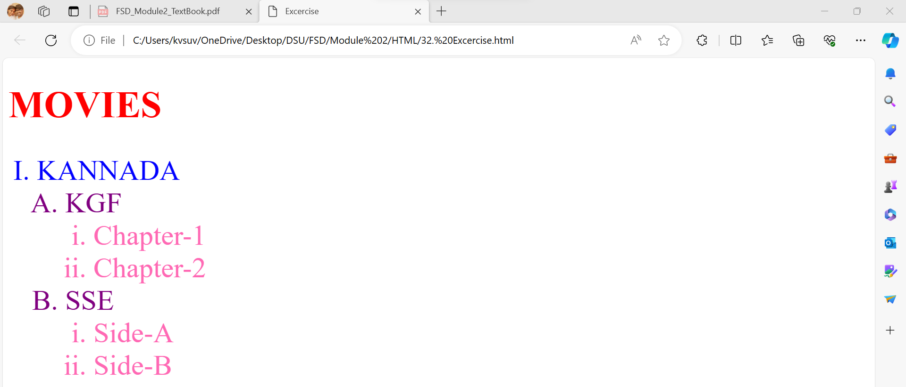
Implement HTML code for the given output.

Slide 108
Exercise - Solution
<!DOCTYPE html> <html> <head> <title>Exercise</title> <style type="text/css"> h1{font-size: 40pt; color: red;} ol{font-size: 30pt; list-style-type: upper-roman; color: blue;} ol ol{font-size: 30pt; list-style-type: upper-alpha; color: purple;} ol ol ol{font-size: 30pt; list-style-type: lower-roman; color: hotpink;} </style> </head> | <body> <h1>MOVIES</h1> <ol> <li> KANNADA </li> <ol> <li>KGF</li> <ol> <li>Chapter-1</li> <li>Chapter-2</li> </ol> <li>SSE</li> <ol> <li>Side-A</li> <li>Side-B</li> </ol> </ol> </ol> </body> </html>

Slide 109
7. Color
Color Groups
3 Groups
17 Colors
147 Colors
Web Palette – 216 Colors

Slide 110
Color Properties - Code
<!DOCTYPE html> <html> <head> <title>Color</title> <style type="text/css"> th{color: red; font-size: 20pt;} td.green{color: green; font-size: 20pt;} td.purple{color: purple; font-size: 20pt;} td.hotpink{color: hotpink; font-size: 20pt;} </style> </head> <body> | <table border="1" width="60%"> <tr> <th>Subjects</th> <th>Module1</th> <th>Module2</th> </tr> <tr> <td class="green">FSD</td> <td class="purple">HTML</td> <td class="hotpink">CSS</td> </tr> <tr> <td class="green">DMGT</td> <td class="purple">SETS</td> <td class="hotpink">RELATIONS</td> </tr> </table> </body> </html>

Slide 111
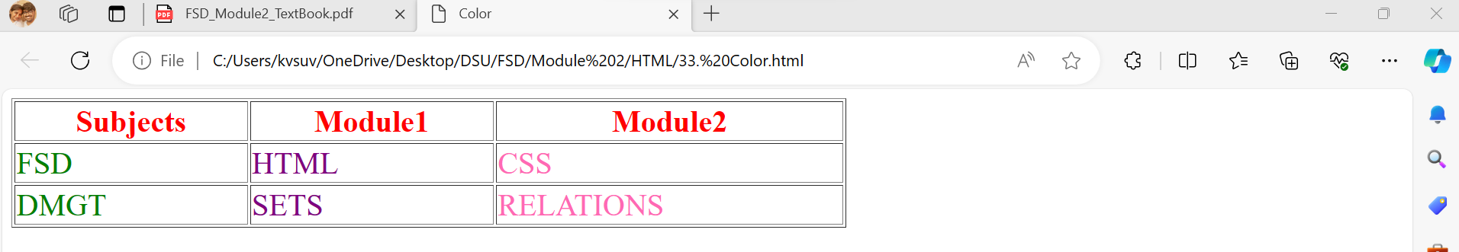
Color Properties – Code - Output

Slide 112
8. Alignment of Text
The text-indent property can be used to indent the first line of a paragraph. This property takes either a length or a percentage value.
The text-align property, most commonly used keyword values are left, center, right, and justify, is used to arrange text horizontally.
The float property is used to specify that text should flow around some element, often an image or a table. The possible values for float are left, right, and none, which is the default.

Slide 113
Alignment of Text - Code
<!DOCTYPE html> <html> <head> <title>Alignmnet of Text</title> <style type="text/css"> h1{text-align: center;} p.one{text-indent: 0.5in; text-align: justify;} img{float:right} </style> </head> | <body> <h1>Dayananda Sagar University</h1> <p> <img src="one.png" alt="error"/> </p> About College <p class="one">Dayananda Sagar Institutions founded in the 60s by one such visionary, late Sri Dayananda Sagar committed to take knowledge to the people, transforms today’s students into responsible citizens and professional leaders of tomorrow.</p> </body> </html>

Slide 114
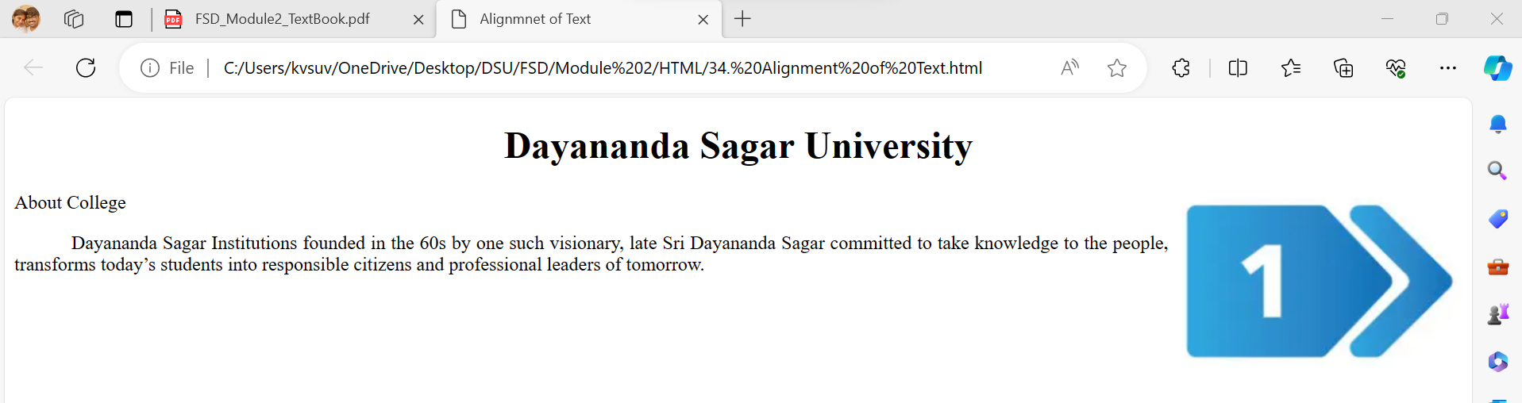
Alignment of Text – Code - Output

Slide 115
9. Background Images
The background-image property is used to place an image in the background of an element.
The background image is replicated as necessary to fill the area of the element. This replication is called tiling.
Tiling can be controlled with the background-repeat property, which can take the value repeat (the default), no-repeat, repeat-x, or repeat-y.
The no-repeat value specifies that just one copy of the image is to be displayed.
The repeat-x value means that the image is to be repeated horizontally; repeat-y means that the image is to be repeated vertically.

Slide 116
Background Images
The position of a non repeated background image can be specified with the background-position property, which can take a large number of different values.
The keyword values are top, center, bottom, left, and right, all of which can be used in combinations.
It is easiest to use one keyword to specify the horizontal placement and one to specify the vertical placement, such as top left, bottom right, and top center.
If only one keyword is given, the other is assumed to be center. So, top is equivalent to top center (or center top), and left is the same as center left (or left center).

Slide 117
Background Images – Code1
<!DOCTYPE html>
<html>
<head>
<title>Background Image1</title>
<style type="text/css">
body {background-image: url(one.png); background-size: 375px 300px;}
p {font-size: 40pt; text-align: justify;}
</style>
</head>
<body>
<h1>Dayananda Sagar University</h1>
<p class="one">Dayananda Sagar Institutions founded in the 60s by one such visionary, late Sri Dayananda Sagar committed to take knowledge to the people, transforms today’s students into responsible citizens and professional leaders of tomorrow.</p>
</body>
</html>

Slide 118

Background Images – Code1 - Output

Slide 119
Background Images – Code2
<!DOCTYPE html>
<html>
<head>
<title>Background Image2</title>
<style type="text/css">
p.one {background-image: url(one.png); background-repeat: repeat-x;}
p.two {background-image: url(two.png); background-repeat: repeat-y;}
</style>
</head>
<body>
<h1>Dayananda Sagar University</h1>
<p class="one">Dayananda Sagar Institutions founded in the 60s by one such visionary, late Sri Dayananda Sagar.</p>
<p class="two">He was committed to take knowledge to the people, transforms today’s students into responsible citizens and professional leaders of tomorrow. He was committed to take knowledge to the people, transforms today’s students into responsible citizens and professional leaders of tomorrow. He was committed to take knowledge to the people, transforms today’s students into responsible citizens and professional leaders of tomorrow.</p>
</body>
</html>

Slide 120
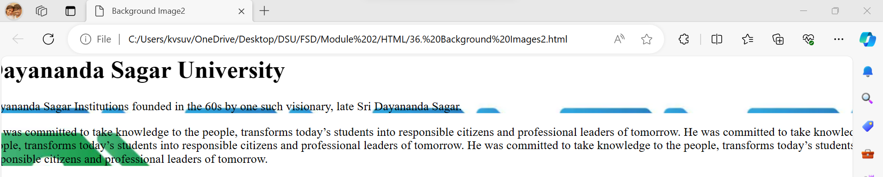
Background Images – Code2 - Output

Slide 121
Background Images – Code3 - URL
<!DOCTYPE html>
<html>
<head>
<title>Background Image3</title>
<style type="text/css">
p {background-image: url("C:\\Users\\kvsuv\\OneDrive\\Desktop\\DSU\\FSD\\Module 2\\one.png"); background-size: 375px 300px;}
p {font-size: 40pt; text-align: justify;}
</style>
</head>
<body>
<h1>Dayananda Sagar University</h1>
<p class="one">Dayananda Sagar Institutions founded in the 60s by one such visionary, late Sri Dayananda Sagar committed to take knowledge to the people, transforms today’s students into responsible citizens and professional leaders of tomorrow.</p>
</body>
</html>

Slide 122

Background Images – Code3 – URL - Output

Slide 123
<span>
In many situations , we want to apply special font properties to less than a whole paragraph of text may be for a single word.
By default, span doesn’t have any implied layout.

Slide 124
<span> - Code
<!DOCTYPE html>
<html>
<head>
<title>Span</title>
<style type="text/css">
p{font-size: 20pt;}
.one{font-size: 30pt; color: red;}
</style>
</head>
<body>
<p> My favourite subject is <span class="one">FSD</span></p>
</body>
</html>

Slide 125
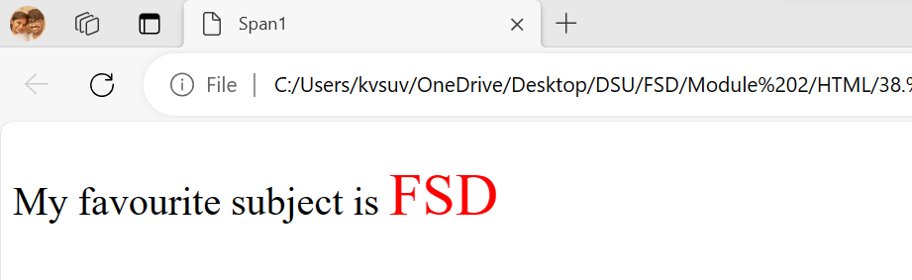
<span> - Code - Output

Slide 126
<div>
We can apply a style to a section of document rather than to each paragraph . This can be done with the <div> tag.
By default, span doesn’t have implied layout.

Slide 127
<div> - Code
<!DOCTYPE html>
<html>
<head>
<title>Div</title>
<style type="text/css">
.one{font-size: 30pt; color: red;}
.two{font-size: 25pt; color: blue;}
</style>
</head>
<body>
<div class="one">
<p> My favourite subject is FSD</p>
<p> My favourite module is CSS</p>
</div>
<div class="two">
<p> My favourite subject is FSD</p>
<p> My favourite module is CSS</p>
</div>
</body>
</html>

Slide 128
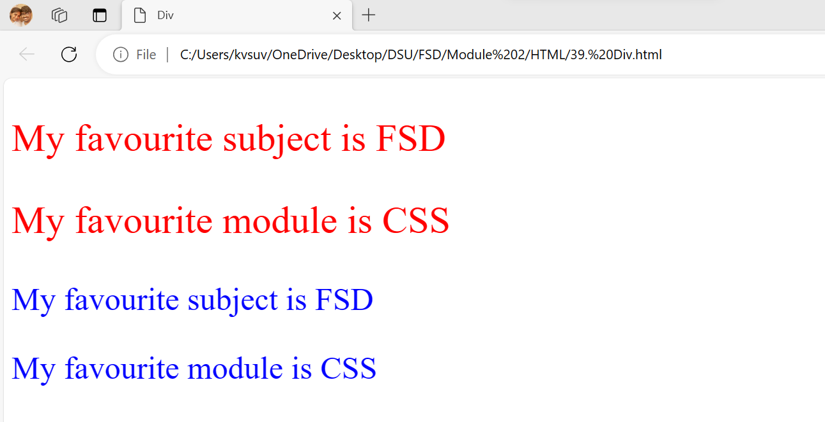
<div> - Code - Output

Slide 129
10. Conflict Resolution
When style sheets at 2 or more levels specify different value for same property on some element.
The inline level gets the highest priority over the document level.
The document level gets the higher priority over the external level.

Slide 130
Conflict Resolution
2. A property value conflict may occur within a single style sheet. Consider the following style specifications, which are next to each other in the same document-level style sheet:
h3 {color: blue;}
body h3 {color: red;}
Both these specifications apply to all h3 elements in the body of the document.
The browser has to resolve this conflict

Slide 131
Conflict Resolution
3. Another source of conflict can arise from the fact that there can be several different origins of the specification of property values.
For example, they may come from a style sheet written by the author of the document itself but they may come from the browser user and from the browser.

Slide 132
Conflict Resolution
The property value specifications can be marked as being important by including !important in the specification. For example, in the specification:
p.special {font-style: italic !important; font-size: 1.2em}

Slide 133
Conflict Resolution
The process of conflict resolution is a multi stage process.
Step 1: Gather information about levels of style sheet. All the origins and weights are sorted. The following rules are considered: The precedence is followed as below:
1. Important declarations with user origin
2. Important declarations with author origin
3. Normal declarations with author origin
4. Normal declarations with user origin
5. Any declarations with browser (or other user agent) origin.

Slide 134
Conflict Resolution
The process of conflict resolution is a multi stage process.
Step 2: If there are other conflicts even after sorting ,The next step is sorting by specificity. Rules are:
1. id selectors
2. Class and pseudo class selectors
3. Contextual selectors (more element type names means that they are more specific)
4. Universal selectors
If there still conflicts, they are resolved by giving precedence to most recently seen specification.
The whole sorting process that is used to resolve style specification conflicts is called the cascade.

Slide 135
Conflict Resolution
Inheritance is another source of property-value conflicts; although as we already know, the inherited property value is always overridden by the property value given to the descendant element.
A child element always inherits the styles of the parent element, unless declared otherwise separately. Even here, if the declarations are not in conflict, they simply merge.

Slide 136
Conflict Resolution – Inheritance - Code
<!DOCTYPE html>
<html>
<head>
<title>Inheritance</title>
<style type="text/css">
.one{font-size: 30pt; color: red;}
.two{font-size: 25pt; color: blue;}
.three{font-size: 25pt; color: hotpink;}
</style>
</head>
<body>
<p class="one">
<p class="two"> My favourite subject is FSD</p>
</p>
<p class="one">
<p class="two three"> My favourite subject is FSD</p>
</p>
</body>
</html>

Slide 137
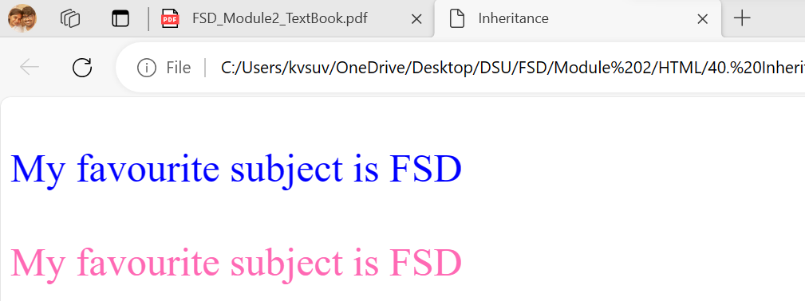
Conflict Resolution – Inheritance – Code - Output

Slide 138
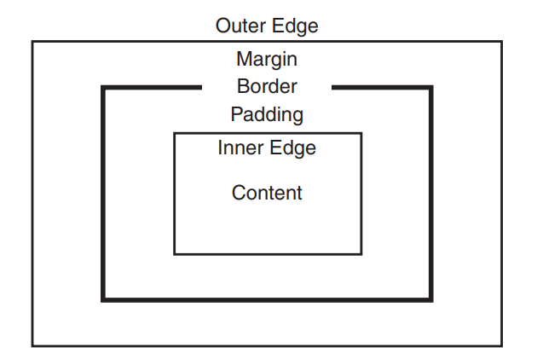
11. CSS - Box Model
Virtually all document elements can have borders with various styles, such as color and width.
The amount of space between the content of an element and its border, known as padding, can be specified, as well as the space between the border and an adjacent element, known as the margin. This model, called the box model.
Figure: The Box Model

Slide 139
Borders
Border-style → border-top-style, border-bottom-style, border-left-style, border-right-style
Values → dotted, dashed, solid, double
Border-width → border-top-width, border-bottom-width, border-left-width, border-right-width
Values → thin, medium, thick
Border-color → border-top-color, border-bottom-color, border-left-color, border-right-color

Slide 140
Borders
The shorthand for setting the style properties of all four borders of an element, border.
border: 5px solid blue;
The equivalent code is:
border_width: 5px; border-style: solid; border-color: blue;
The cells of a table can have borders, like any other element:
td, th {border: thin solid black;}

Slide 141
Borders - Code
<!DOCTYPE html> <html> <head> <title>Borders</title> <style type="text/css"> td, th {border: thin solid black;} table{border: thin solid black; border-collapse: collapse; border-top-width: medium; border-bottom-width: thick; border-top-color: red; border-bottom-color: blue; border-top-style: dotted; border-bottom-style: dashed;} </style> </head> <body> | <table border=“border”> <tr> <th>Subjects</th> <th>Module1</th> <th>Module2</th> </tr> <tr> <td class="green">FSD</td> <td class="purple">HTML</td> <td class="hotpink">CSS</td> </tr> <tr> <td class="green">DMGT</td> <td class="purple">SETS</td> <td class="hotpink">RELATIONS</td> </tr> </table> </body> </html>

Slide 142
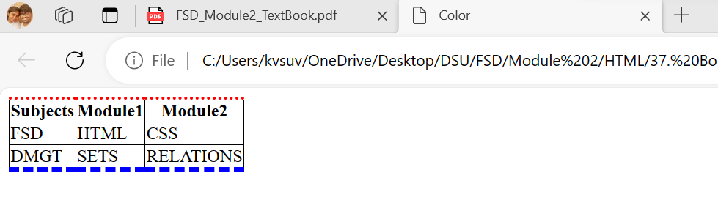
Borders – Code - Output

Slide 143
Margins and Padding
Padding is the space between the content of an element and its border.
Margin is the space between the border of an element and the element’s neighbors.
When there is no border, the margin plus the padding is the space between the content of an element and its neighbors.
There is a difference when the element has a background: The background extends into the padding, but not into the margin.
Margin Properties → margin → margin-left, margin-right, margin-top, and margin-bottom.
Padding Properties → padding → padding-left, padding-right, padding-top, and padding-bottom.

Slide 144
Margins and Padding - Code
<!DOCTYPE html> <html> <head> <title>Margins and Padding</title> <style type="text/css"> p.one{margin: 15px; padding: 15px; background-color:red; border-style:solid;} p.two{margin: 35px; padding: 25px; background-color:hotpink; border-style:solid;} </style> </head> | <body> <p class="one">Dayananda Sagar Institutions founded in the 60s by one such visionary, late Sri Dayananda Sagar committed to take knowledge to the people, transforms today’s students into responsible citizens and professional leaders of tomorrow. </p> <p class="two">Dayananda Sagar Institutions founded in the 60s by one such visionary, late Sri Dayananda Sagar committed to take knowledge to the people, transforms today’s students into responsible citizens and professional leaders of tomorrow. </p> </body> </html>

Slide 145
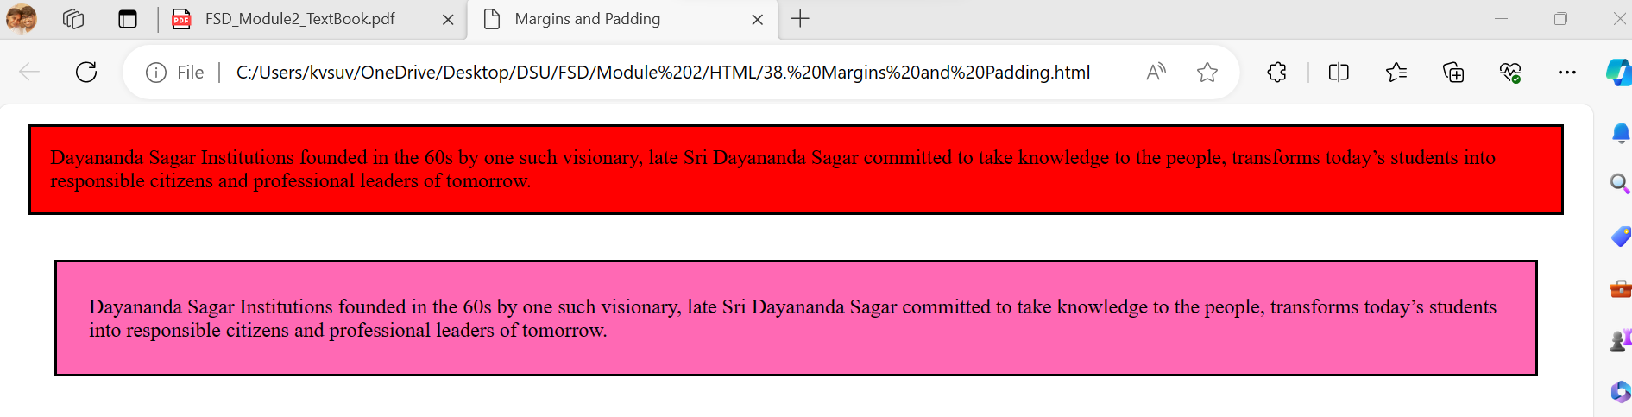
Margins and Padding – Code - Output

Slide 146
12. CSS3 Features - Box Shadow
The box-shadow property attaches one or more shadows to an element.
Value | Description
None | Default value, No shadow is displayed
H-offset | The horizontal offset of the shadow. A positive value puts the shadow on the right side of a Box. A negative value puts the shadow on left side of the box.
V-offset | The vertical offset of the shadow. A positive value puts the shadow below the box. A negative value puts the shadow above the box.
Blur | Optional. The blur radius ,the higher the number ,the more blurred the shadow will be.
Color | The color of the shadow, the default value is text color.

Slide 147
Box Shadow – Code
<!DOCTYPE html>
<html>
<head>
<style>
#ex1{border: 1px solid; padding: 10px; box-shadow: 5px 10px 8px blue;}
#ex2{border: 1px solid; padding: 10px; box-shadow: -5px -10px 28px red;}
</style>
</head>
<body>
<p id="ex1">My fav sub is FSD</p> <br> <br>
<p id="ex2">My fav food is Maggie</p>
</body>
</html>

Slide 148
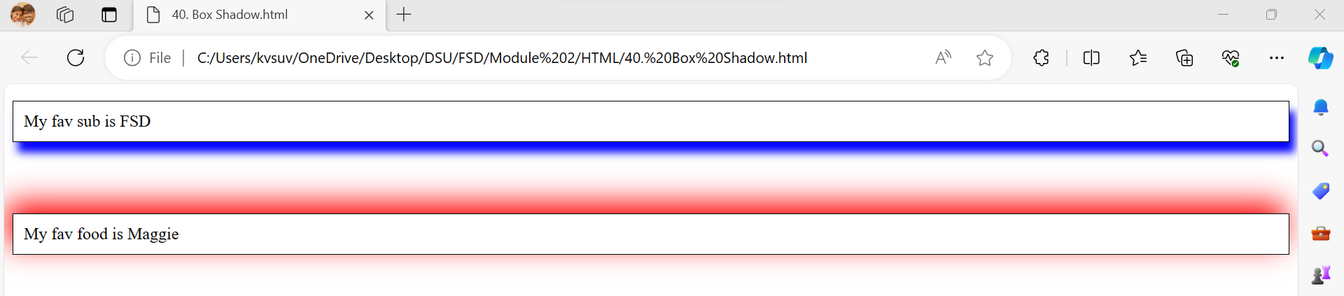
Box Shadow – Code - Output

Slide 149
12. CSS3 Features - Opacity
The opacity property specifies the opacity/transparency of an element.
Opacity value can take a value from 0.0 -1.0. The lower value, the more transparent.

Slide 150
CSS3 Features – Opacity – Code1
<!DOCTYPE html>
<html>
<head>
<title> Opacity1 </title>
</head>
<body>
<h1> Image Transparency </h1>
<p> Image with NO opacity </p>
<img src="one.png" alt="One" width="200" height="150">
</body>
</html>
Image with no opacity

Slide 151

CSS3 Features – Opacity – Code1 - Output

Slide 152
CSS3 Features – Opacity – Code2
<!DOCTYPE html>
<html>
<head>
<title> Opacity2 </title>
<style>
img{opacity: 0.4;}
</style>
</head>
<body>
<h1> Image Transparency </h1>
<p> Image with 40% opacity </p>
<img src="one.png" alt="One" width="200" height="150">
</body>
</html>
Image with 40% opacity

Slide 153

CSS3 Features – Opacity – Code2 - Output

Slide 154

12. CSS3 Features – Rounded Corners
With the CSS border-radius property, we can give any element “Rounded Corners”.

Slide 155
Rounded Corners - Code
<!DOCTYPE html>
<html>
<head>
<title> Rounded Corners </title>
<style>
#rcorners1{border-radius: 25px; padding: 20px; background: #73AD21; width: 200px; height: 150px;}
#rcorners2{border-radius: 45px; padding: 20px; border: 2px solid #73AD21; width: 200px; height: 150px;}
#rcorners3 {border-radius: 25px; padding: 20px; background: url(one.png); background-position: left top; width: 200px; height: 150px;}
</style>
</head>

Slide 156
Rounded Corners - Code
<body>
<h1>The border-radius Property</h1>
<p>Rounded corners for an element with a specified background color:</p>
<p id="rcorners1">Rounded corners!</p>
<p>Rounded corners for an element with a border:</p>
<p id="rcorners2">Rounded corners!</p>
<p>Rounded corners for an element with a background image:</p>
<p id="rcorners3">Rounded corners!</p>
</body>
</html>

Slide 157

Rounded Corners – Code - Output

Slide 158
12. CSS3 Features – Attribute Selector
Styling HTML elements with specific Attributes:
It is possible to Style HTML elements that have specific Attributes or Attribute values.
CSS [Attribute] selector
The [attribute] selector is used to select elements with a specified attribute.
Ex: The following example selects all <a> elements with a target attribute
a[target]{
background-color :yellow;
}

Slide 159
Attribute Selector – Code
<!DOCTYPE html>
<html>
<head>
<title> Attribute Selectors </title>
<style>
a[target] {background-color: yellow;}
</style> </head>
<body>
<h1> Attribute Selectors </h1>
<p>The links with a target attribute gets a yellow background </p>
<a href="https://www.google.com">Google</a>
<a href="http://www.fb.com" target>Facebook</a>
</body>
</html>

Slide 160

Attribute Selector – Code - Output

Slide 161
THANK YOU

